Slide 1

My Bupa
Agent
Your health, handled.
In your language.
Team 4D / Challenge 4: Data
01 / 09
Notes:
My Bupa Agent helps members understand their cover and take the next step.
Pitch timing: 5 seconds.
[Sources]
Current project presentation plan and product definition, 28 September 2026. Prototype boundaries from README.md.
Abstract background generated with the built-in imagegen tool. Prompt retained in .ppt-build/assets/blue-flow-prompt.txt.
[/Sources]

Slide 2
We are the users
01
An unfamiliar
healthcare system
Having insurance
did not make the
next step clear.
02
Cover we struggled
to understand
03
Medical conversations
in a second language
02 / 09
Notes:
We started with a question from our own experience: why can someone have health insurance and still feel unsure about getting care? We were learning a new healthcare system, trying to understand our cover, and dealing with medical language in English. We wanted to make that first step easier for someone like us.
Pitch timing: 30 seconds.
[Sources]
Current project presentation plan and product definition, 28 September 2026. Prototype boundaries from README.md.
[/Sources]

Slide 3
Meet Lin
Lin
01
What does my cover include?
02
Where should I go?
24-year-old international student
New to Melbourne
Bupa OSHC member
03
Can I use my language?
04
How do I get it done?
Illustrative persona
03 / 09
Notes:
Meet Lin, a new international student in Melbourne. She needs to understand her cover, choose where to go, and communicate in her language. Then she still has to complete the booking. Our product follows her through that final step.
Pitch timing: 20 seconds.
[Sources]
Current project presentation plan and product definition, 28 September 2026. Prototype boundaries from README.md.
[/Sources]

Slide 4
Lin has to connect the steps
01
Get an answer
02
Find another screen
03
Enter the details again
Carry her authorised context into the next step.
Journey hypothesis to validate with members
04 / 09
Notes:
Our journey map highlights the handoff between an answer and an appointment. Lin may still have to find another screen and enter the same details again. We want to carry the context she has authorised into that next step, while keeping her in control.
Pitch timing: 20 seconds.
[Sources]
Current project presentation plan and product definition, 28 September 2026. Prototype boundaries from README.md.
[/Sources]

Slide 5
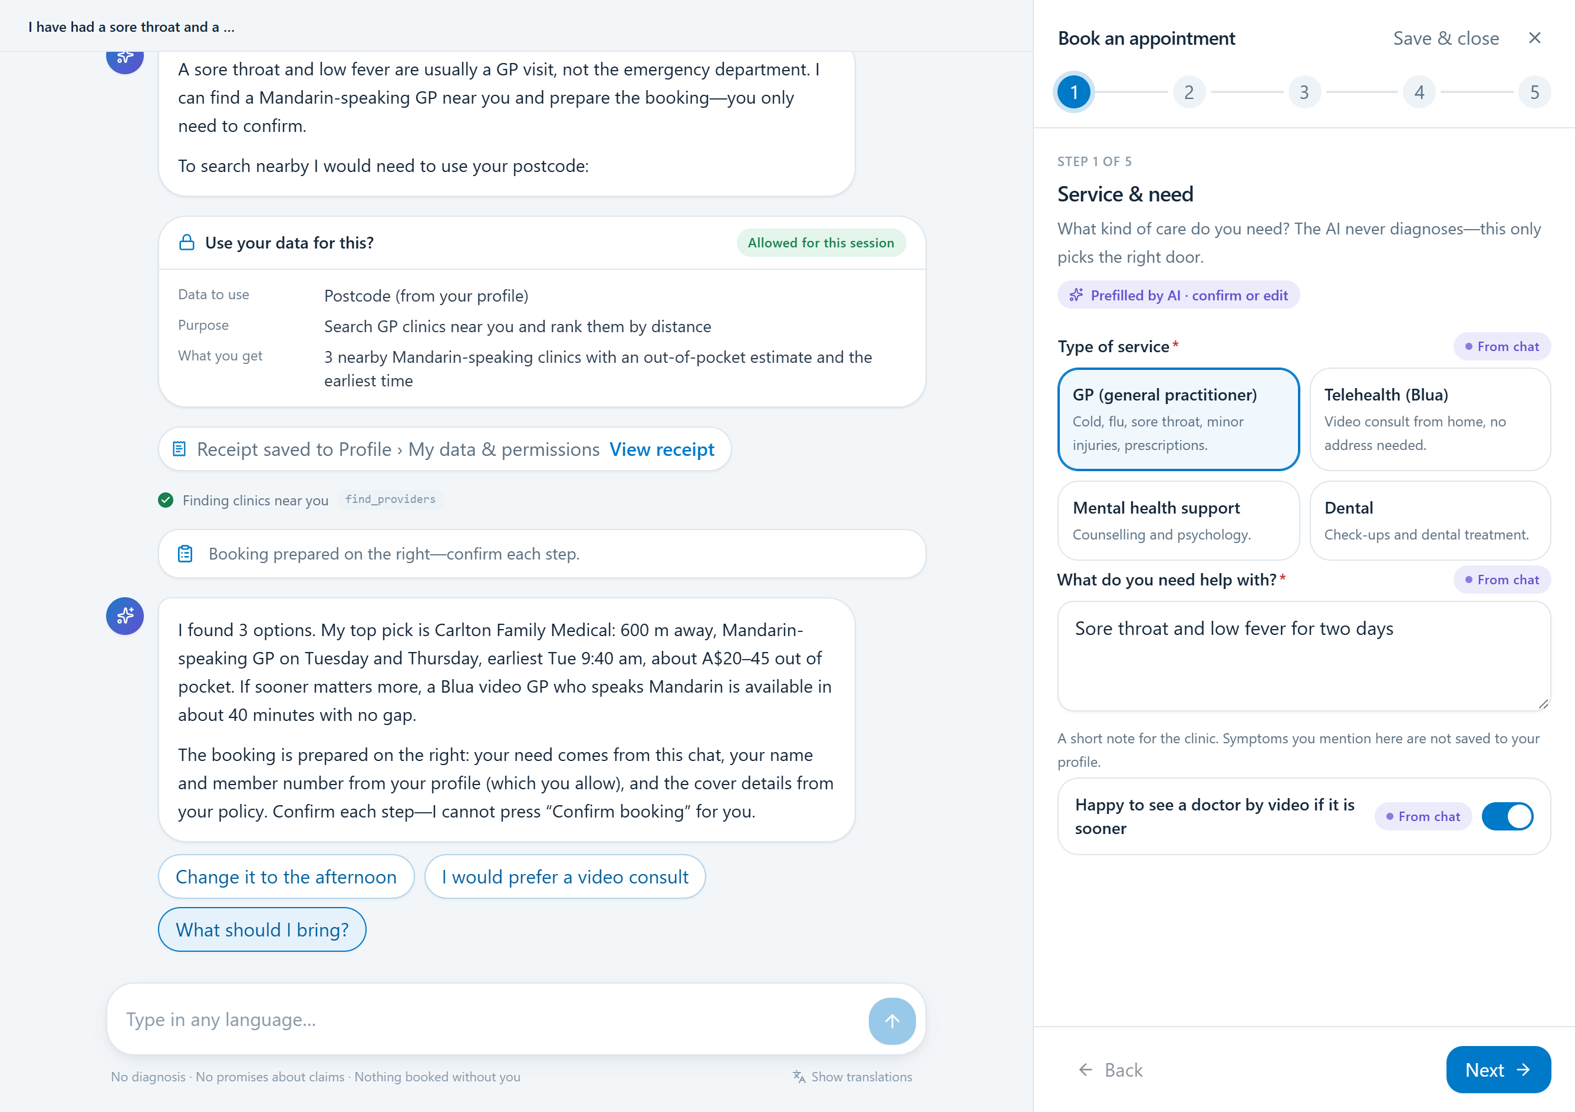
One request, a connected journey
AI Agent
Explain and prepare
Profile
Control permitted data use
Dashboard
Keep the result together
The Agent prepares. You review and submit. / Local prototype, fictional data.
05 / 09
Notes:
My Bupa Agent connects three places. The chat explains and prepares. Profile lets Lin control which information it can use. Dashboard holds her appointments and any health summary she allows. The Agent fills the form, and Lin reviews the details and submits it herself.
Pitch timing: 20 seconds.
[Sources]
Current project presentation plan and product definition, 28 September 2026. Prototype boundaries from README.md.
Screenshots captured from the local project prototype on 28 September 2026. Fictional member data and scripted behaviour.
[/Sources]

Slide 6
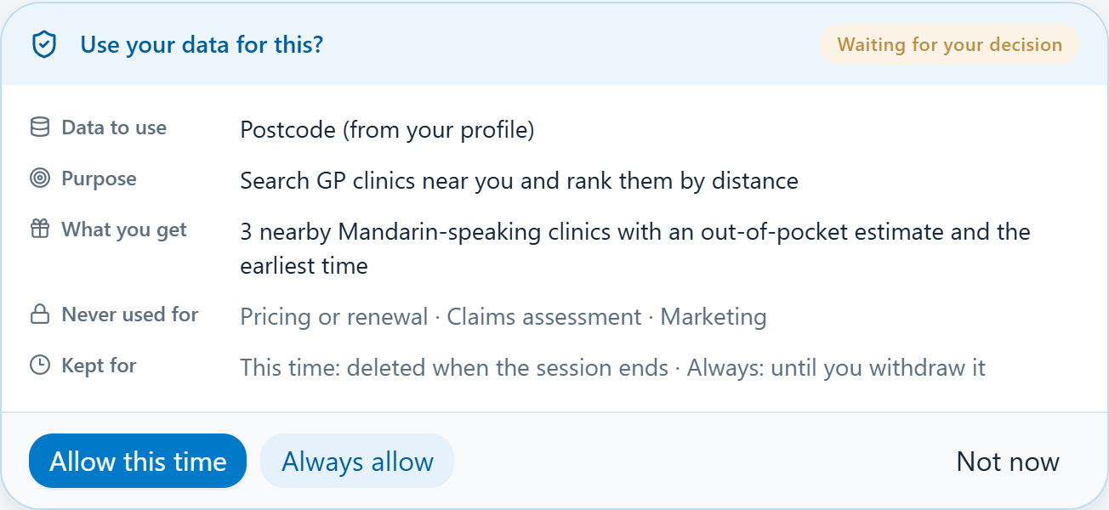
Lin’s first GP booking
Ask in Chinese
Understand the cover context
Share a postcode
A clear purpose and a choice
Review and submit
The appointment lands on Dashboard
Scripted demo. Fictional member, cover and clinic data.
06 / 09
Notes:
Lin asks in Chinese for help arranging a health check. The Agent explains the relevant cover and what still needs confirmation, then prepares the booking form. Here is the key moment: it asks for her postcode to find nearby clinics. She sees the purpose, chooses this time only, and gets relevant options. Each prefilled field shows its source. Lin checks the details and presses Submit herself. The appointment appears on Dashboard, and the permission receipt stays visible in Profile. All member and clinic information here is demo data.
Pitch timing: 50 seconds.
[Sources]
Current project presentation plan and product definition, 28 September 2026. Prototype boundaries from README.md.
General product background: https://www.bupa.com.au/health-insurance/oshc/cover/standard-oshc
Screenshots: local fictional prototype. Cover and provider amounts are demonstration data.
[/Sources]

Slide 7
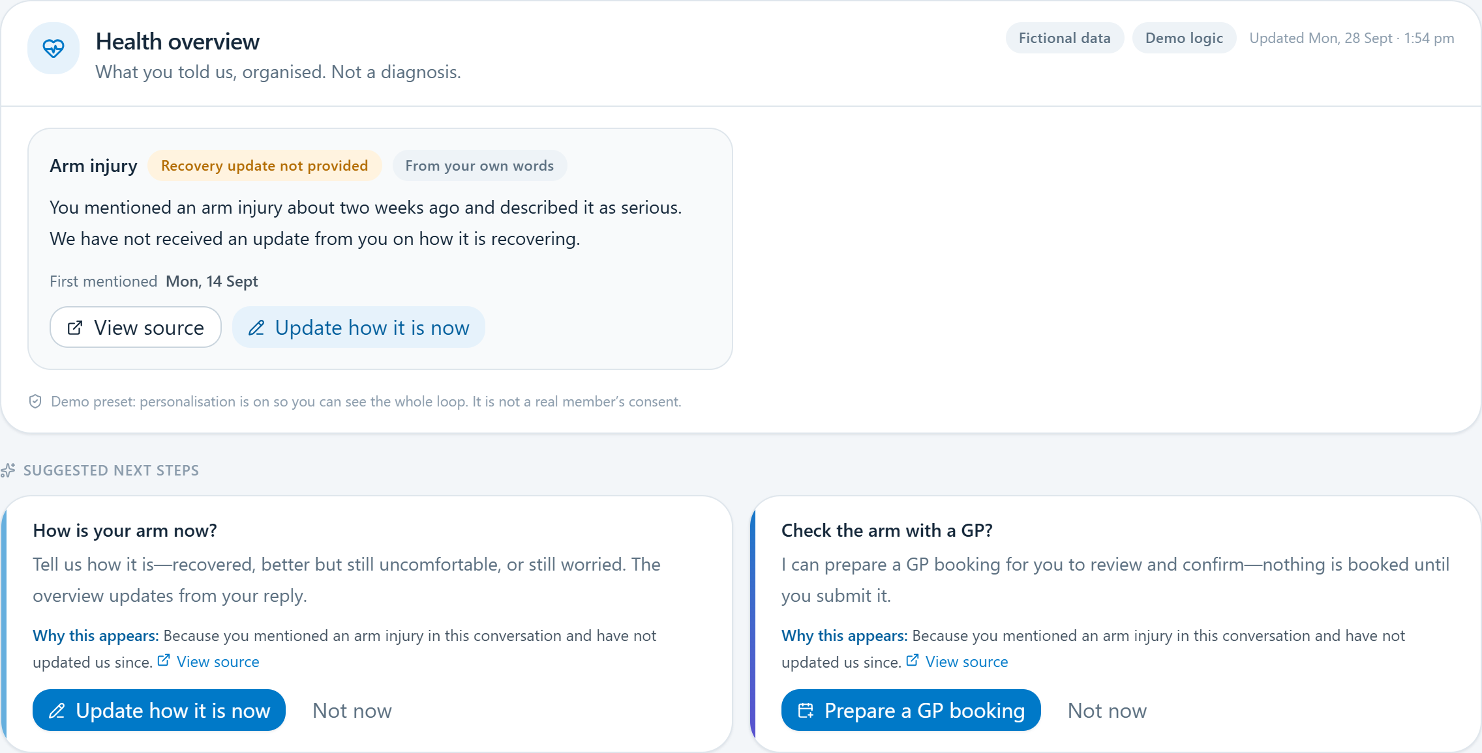
A useful next step,
with permission
Earlier
Lin permits a brief
visit summary.
Today
A suggestion explains
which information it uses.
Follow-up booking, if her doctor recommended it.
Concept walkthrough using the local prototype. Sharing remains optional.
07 / 09
Notes:
With separate permission, Lin can keep a brief record of her arm-injury visit. Later, a reminder explains why it appears and offers help if her doctor recommended follow-up. She can prepare another booking or dismiss it. She can also withdraw permission for future suggestions.
Pitch timing: 20 seconds.
Concept walkthrough. The local demo uses simulated history; do not imply production cloud memory or medical diagnosis. Follow-up is conditional on the clinician’s advice.
[Sources]
Current project presentation plan and product definition, 28 September 2026. Prototype boundaries from README.md.
Screenshots captured from the local project prototype on 28 September 2026. Fictional member data and scripted behaviour.
[/Sources]

Slide 8
The next validation step
Built for demonstration
A 90-day university pilot
Permissions
Booking preparation
Receipts
Test booking completion
and avoidable support calls.
Scripted prototype. Production integration still required.
08 / 09
Notes:
Our scripted prototype demonstrates the journey. Next, we propose approved integrations and a 90-day university pilot to test booking completion and avoidable support calls.
Pitch timing: 12 seconds.
[Sources]
Current project presentation plan and product definition, 28 September 2026. Prototype boundaries from README.md.
[/Sources]

Slide 9
Helping Lin take
the next step
With her permission.
In her language.
My Bupa Agent
09 / 09
Notes:
Helping Lin take the next step. Thank you.
Pitch timing: 3 seconds.
Q&A: Distinguish scripted prototype from approved production integration. Consent withdrawal stops the relevant future use. Do not equate it with deleting all medical or transaction records. Measure task completion and informed consent as well as support contacts.
[Sources]
Current project presentation plan and product definition, 28 September 2026. Prototype boundaries from README.md.
Abstract background generated with the built-in imagegen tool. Prompt retained in .ppt-build/assets/blue-flow-prompt.txt.
[/Sources]

